Slide 1
SARIMAX ML Model
Shawna Tuli

Slide 2

Google Cloud PLATFORM
9% of Google's revenue
$5B in allocation
Historical data from 2019 to 2022
Predicted data from 2022 to 2027

Slide 3
SARIMAX Seasonal Auto-Regressive Integrated Moving Average
SARIMA(p,d,q)(P,D,Q,S) model have all the parameters.
Non-regressive orders
p: Autoregressive order
d: Differencing order
q: Moving average order
Regressive orders
P: Seasonal autoregressive order
D: Seasonal differencing order
Q: Seasonal moving average order
S: Length of the seasonal cycle

Slide 4
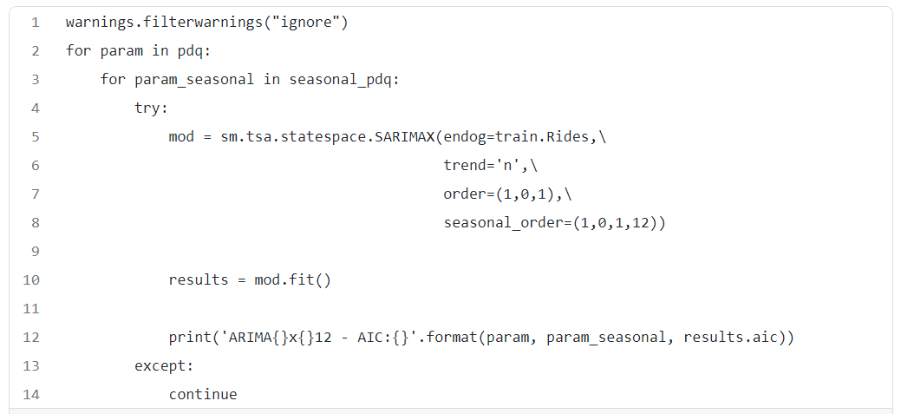
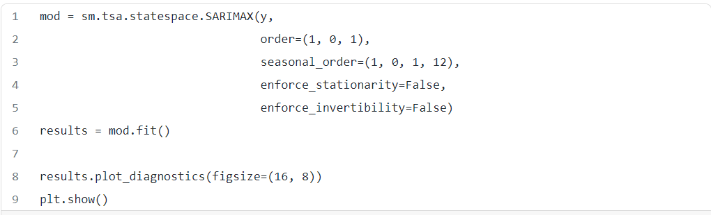

Slide 5
